Slide 1


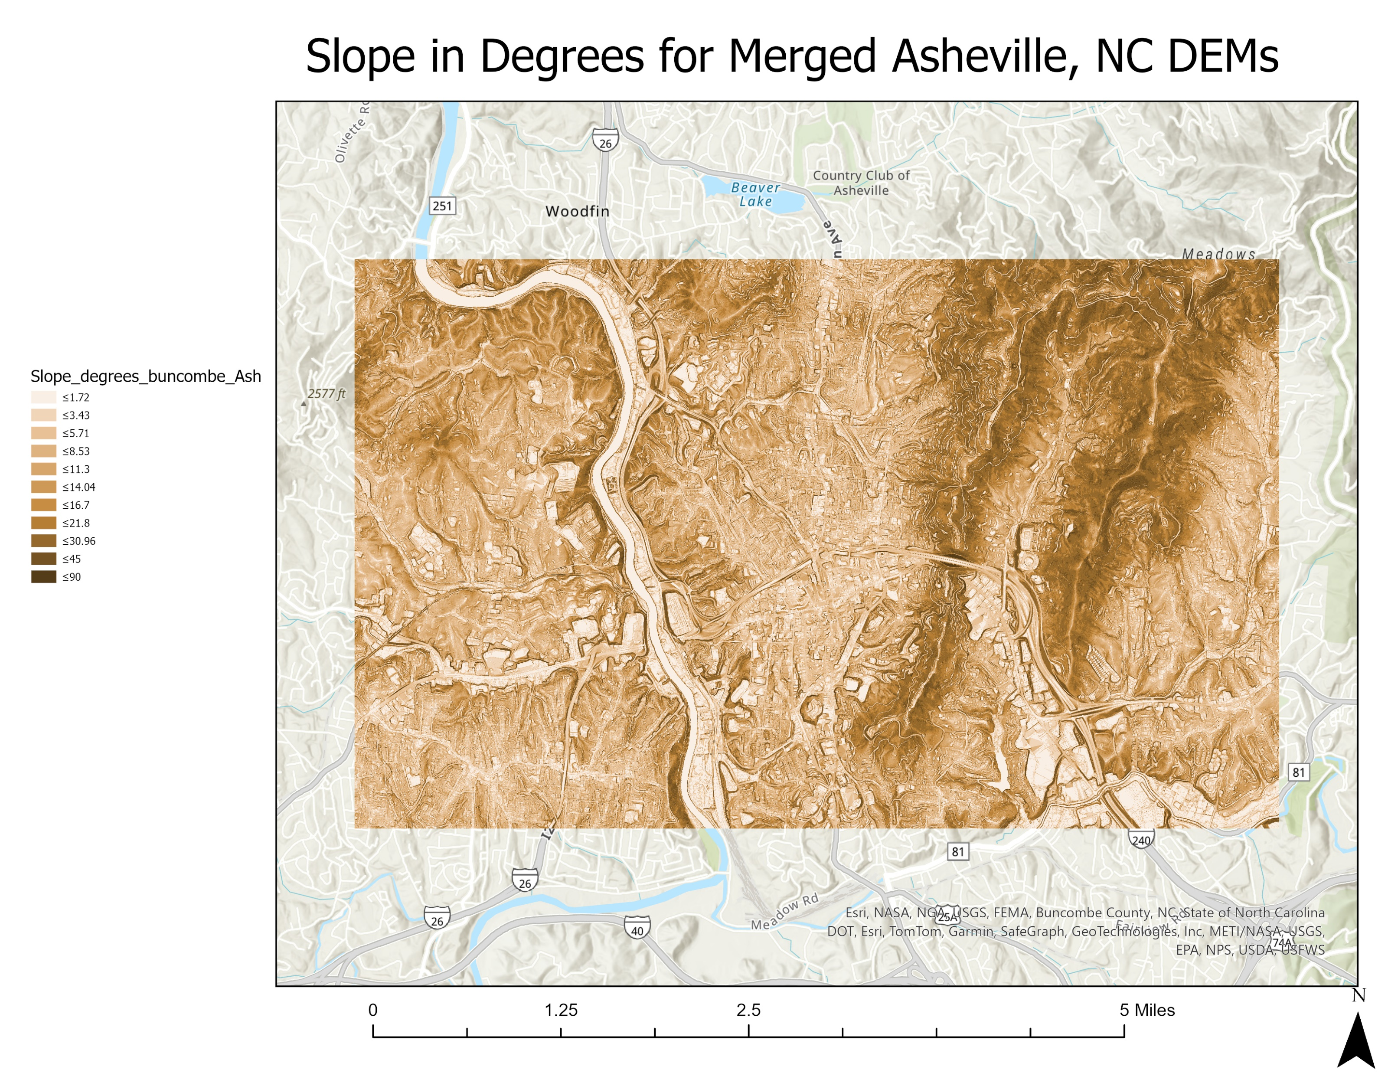
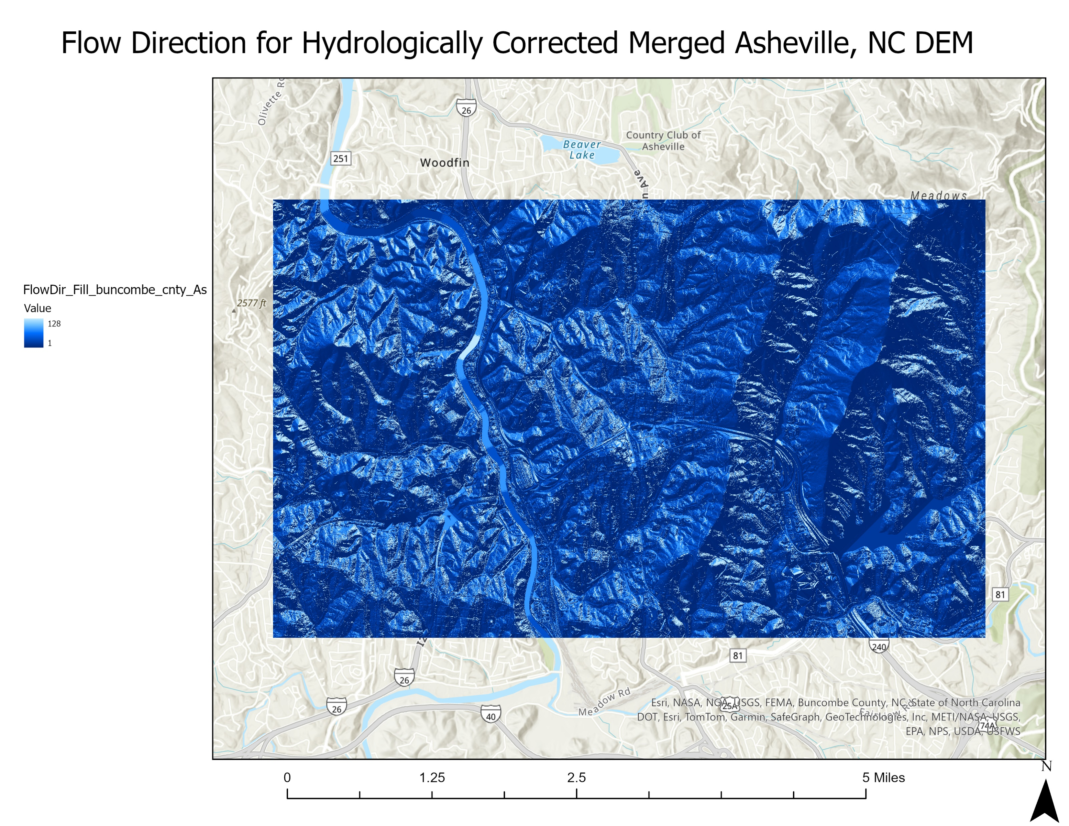
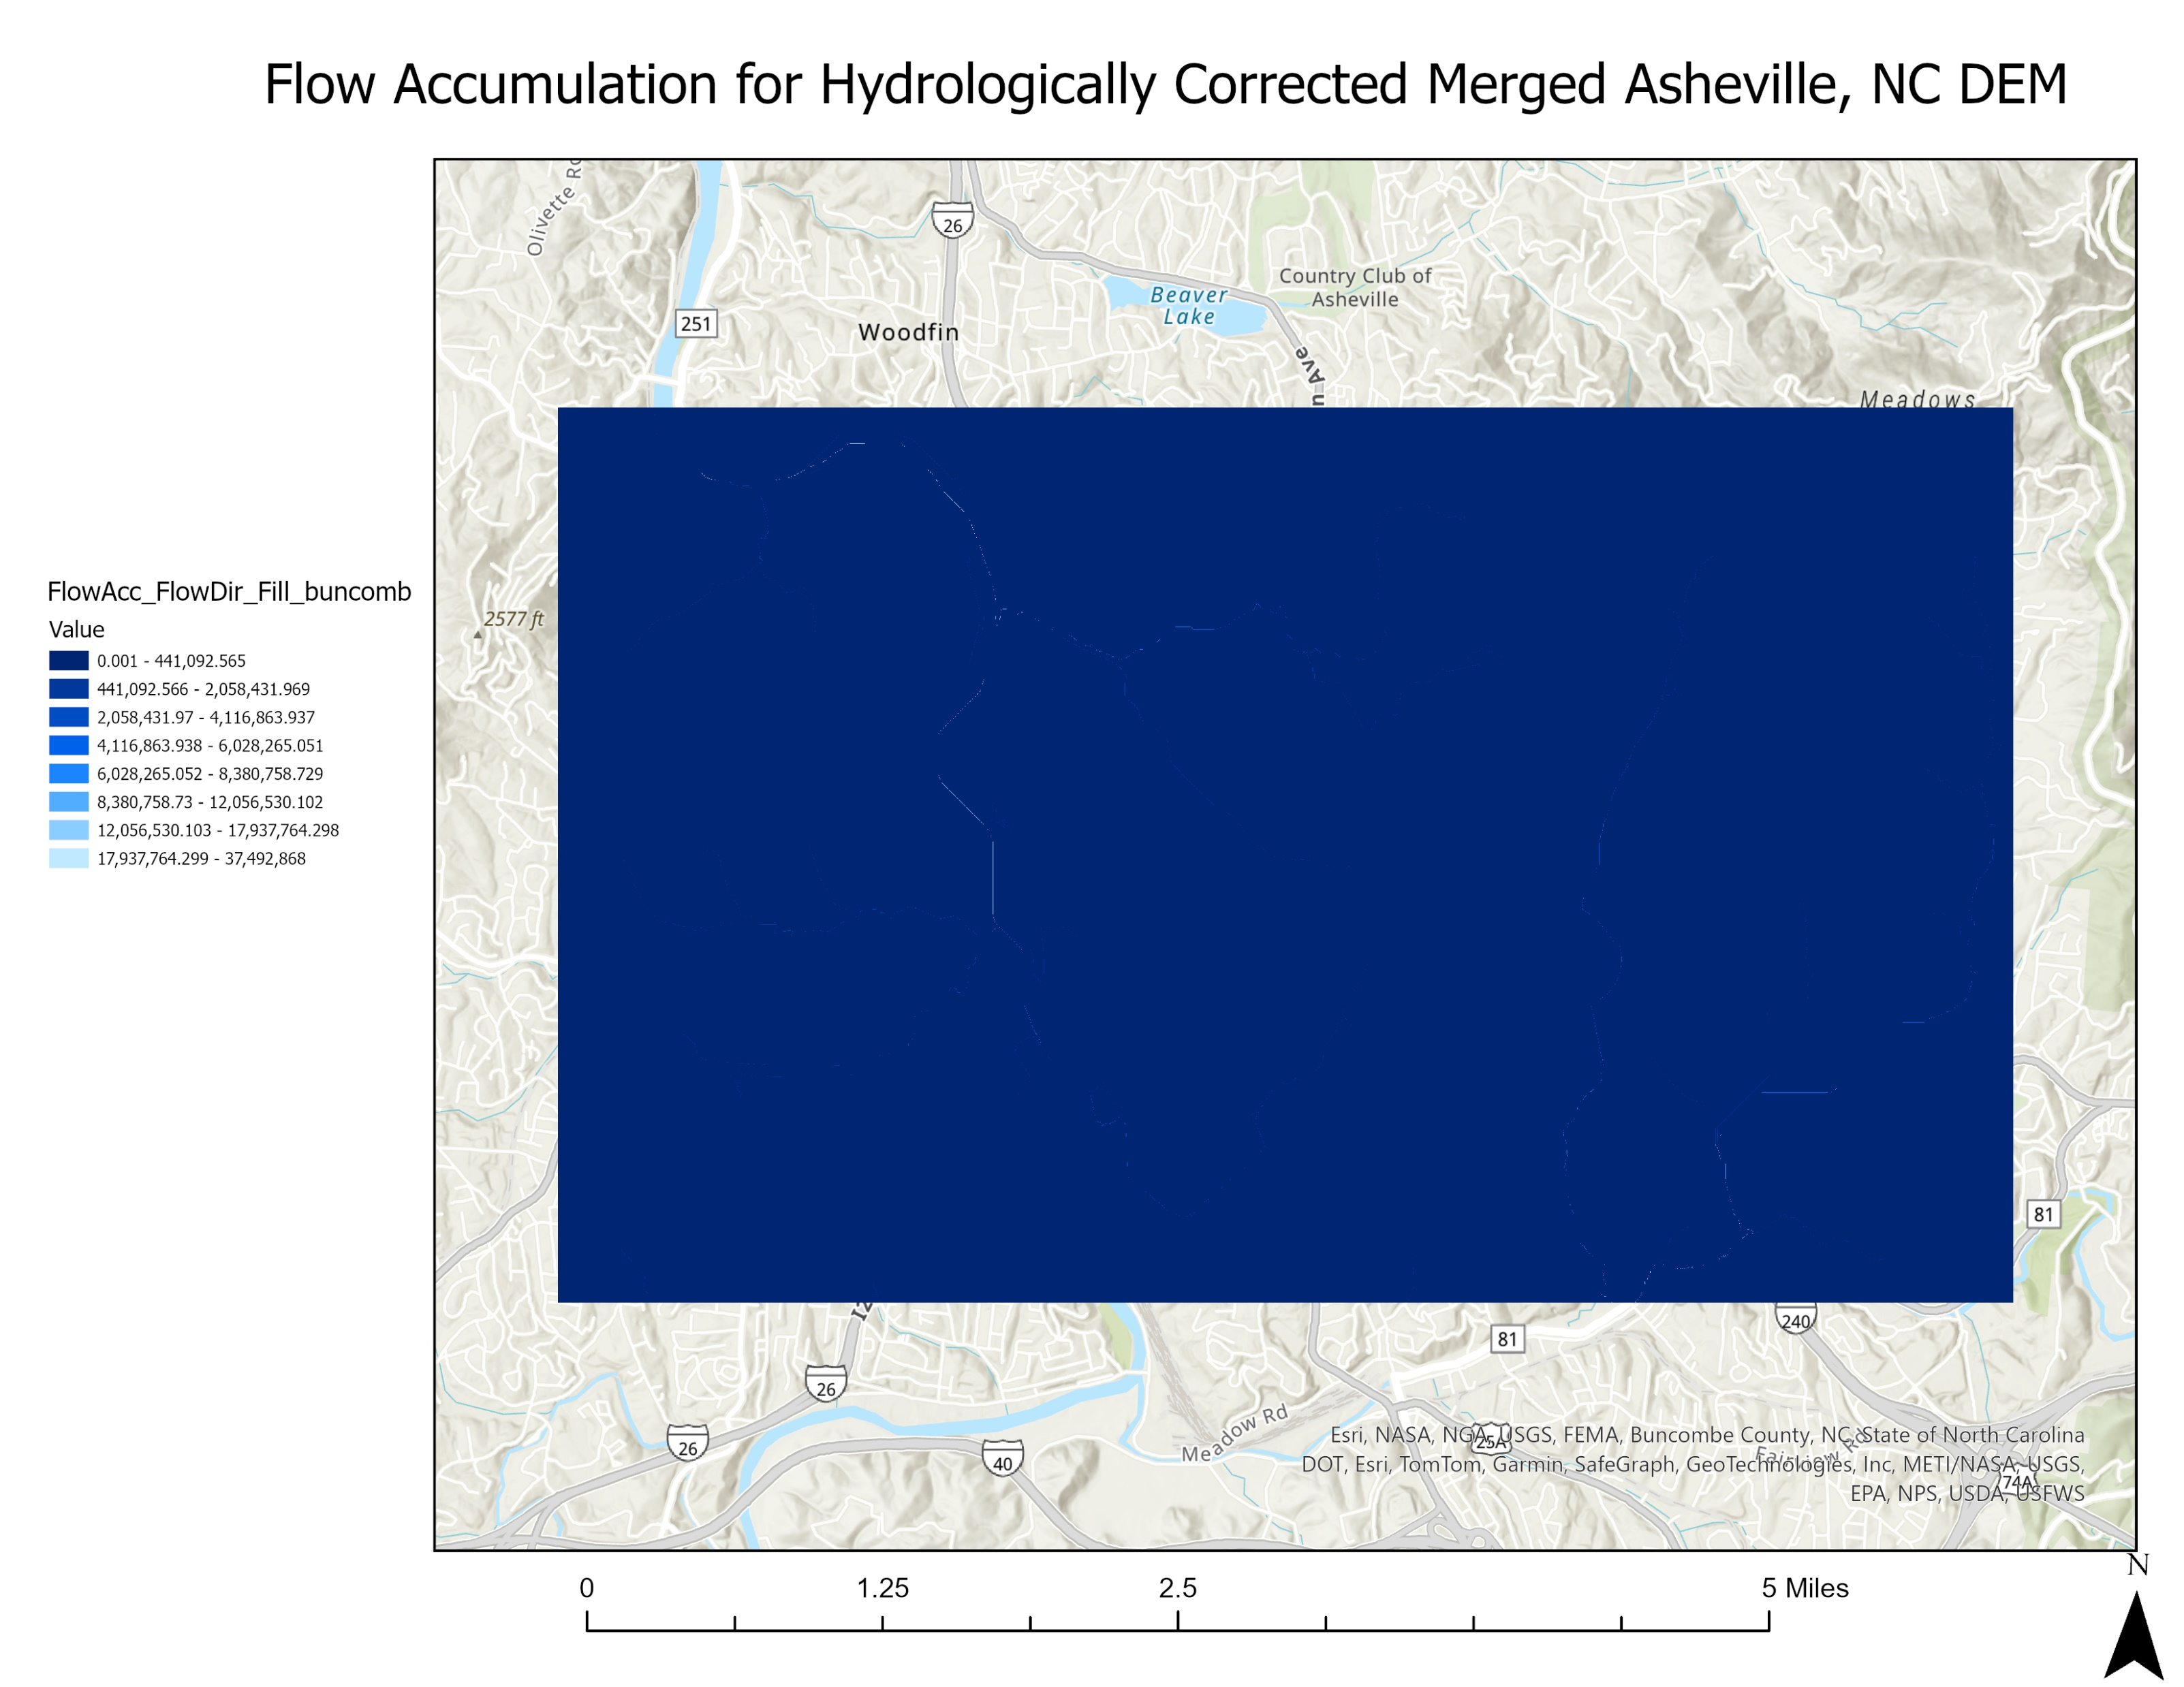
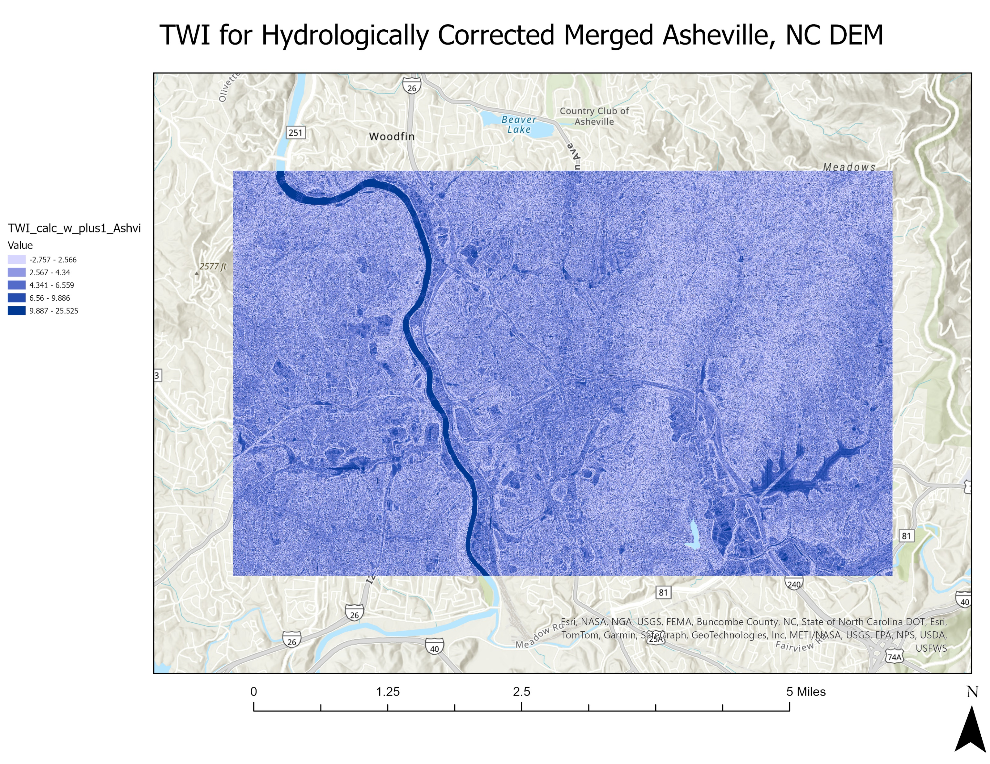
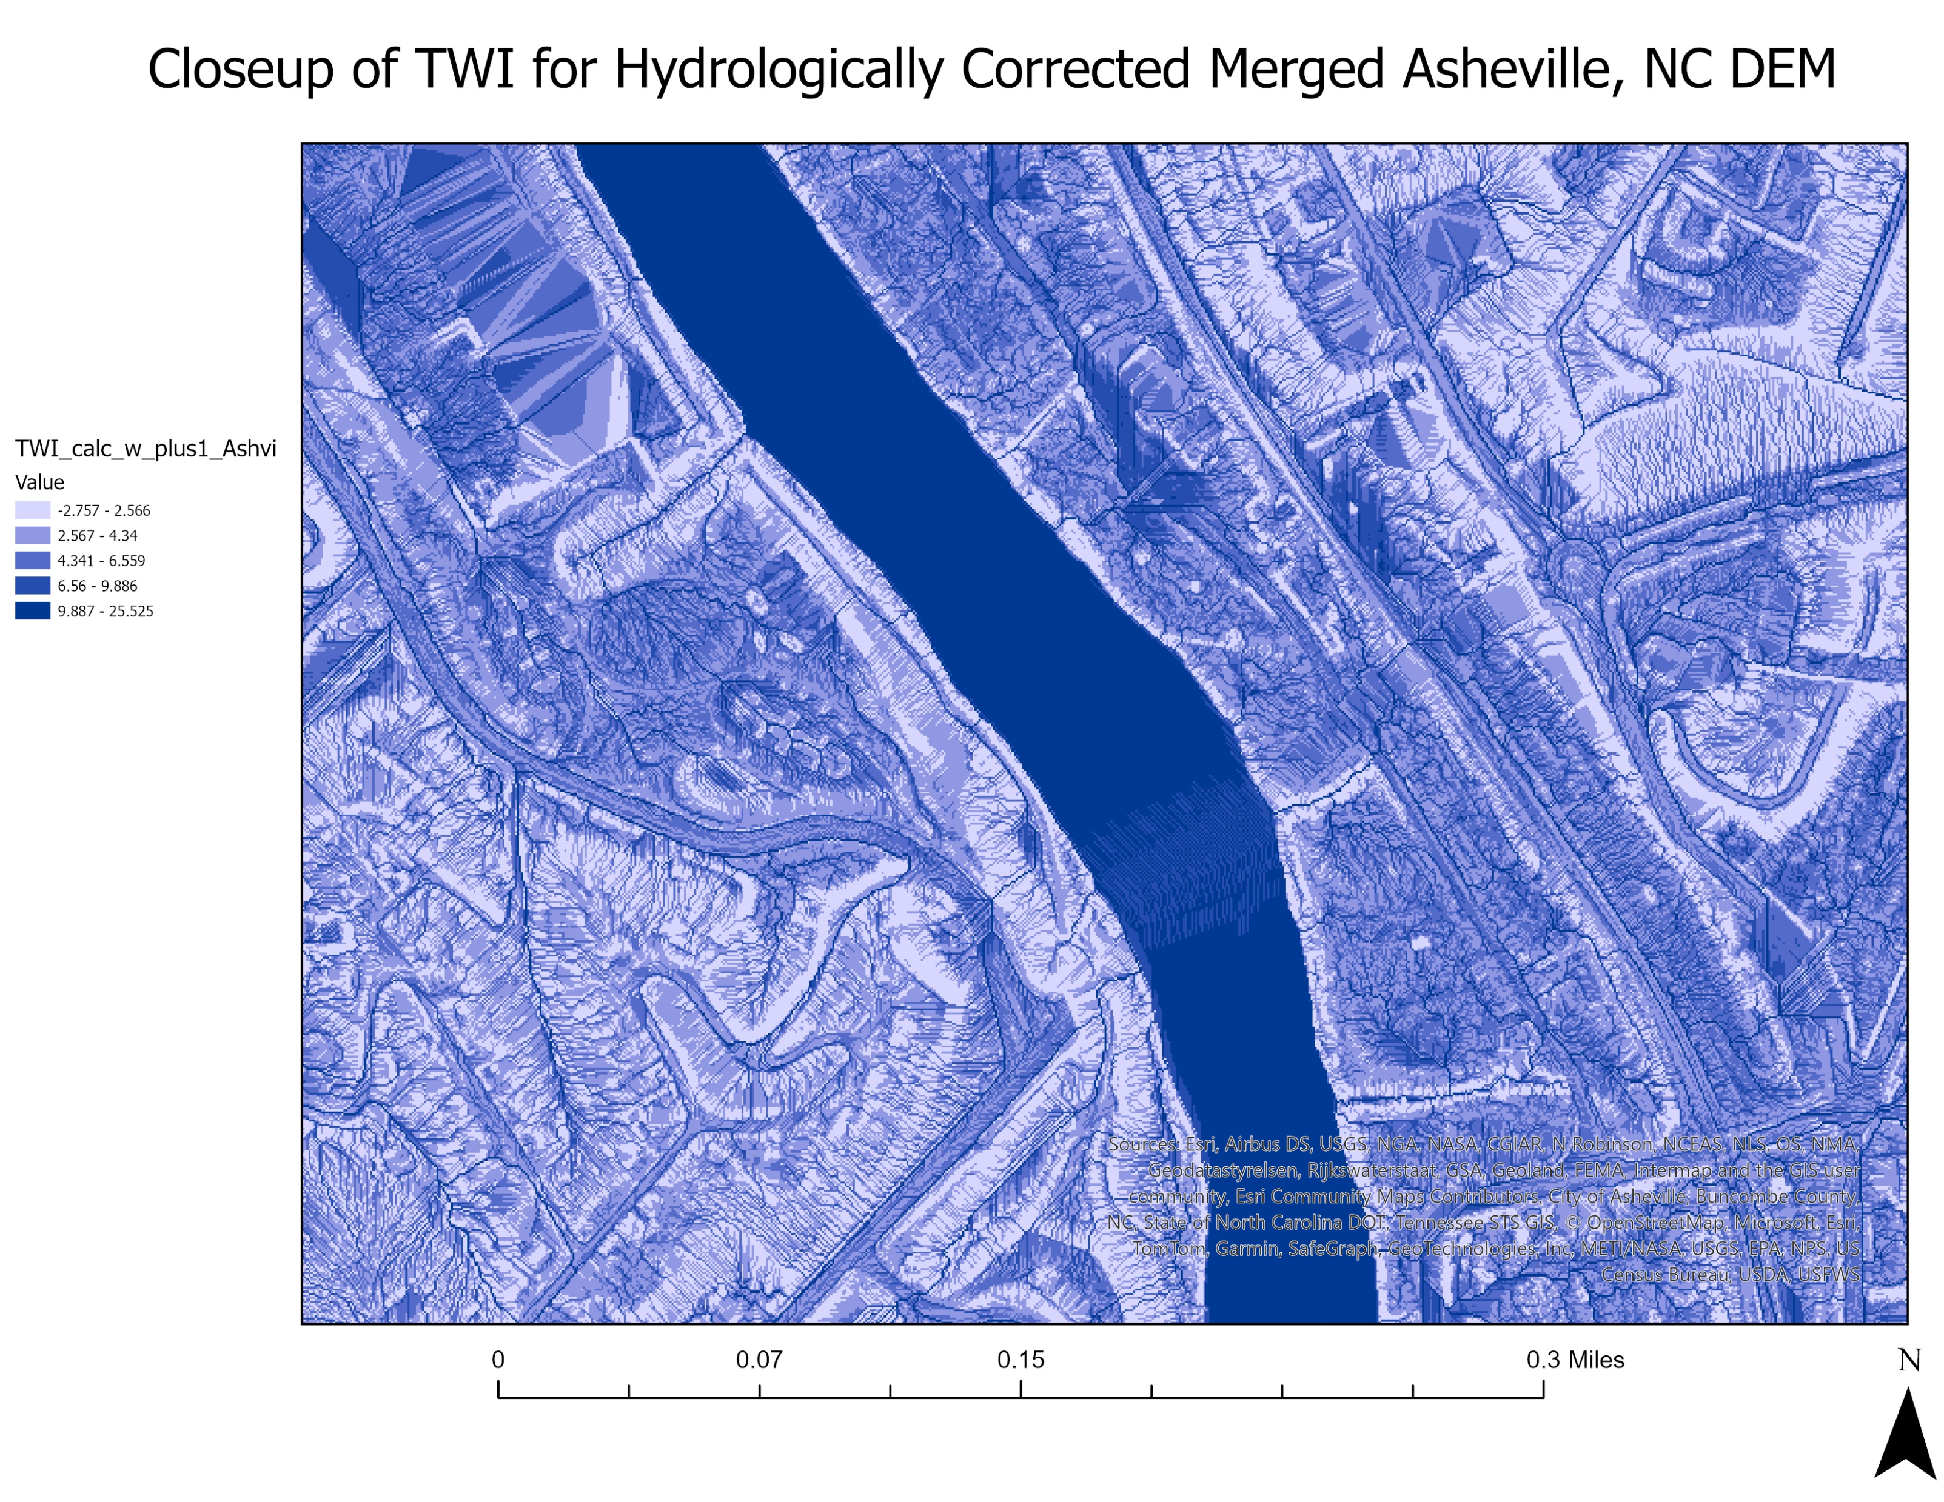
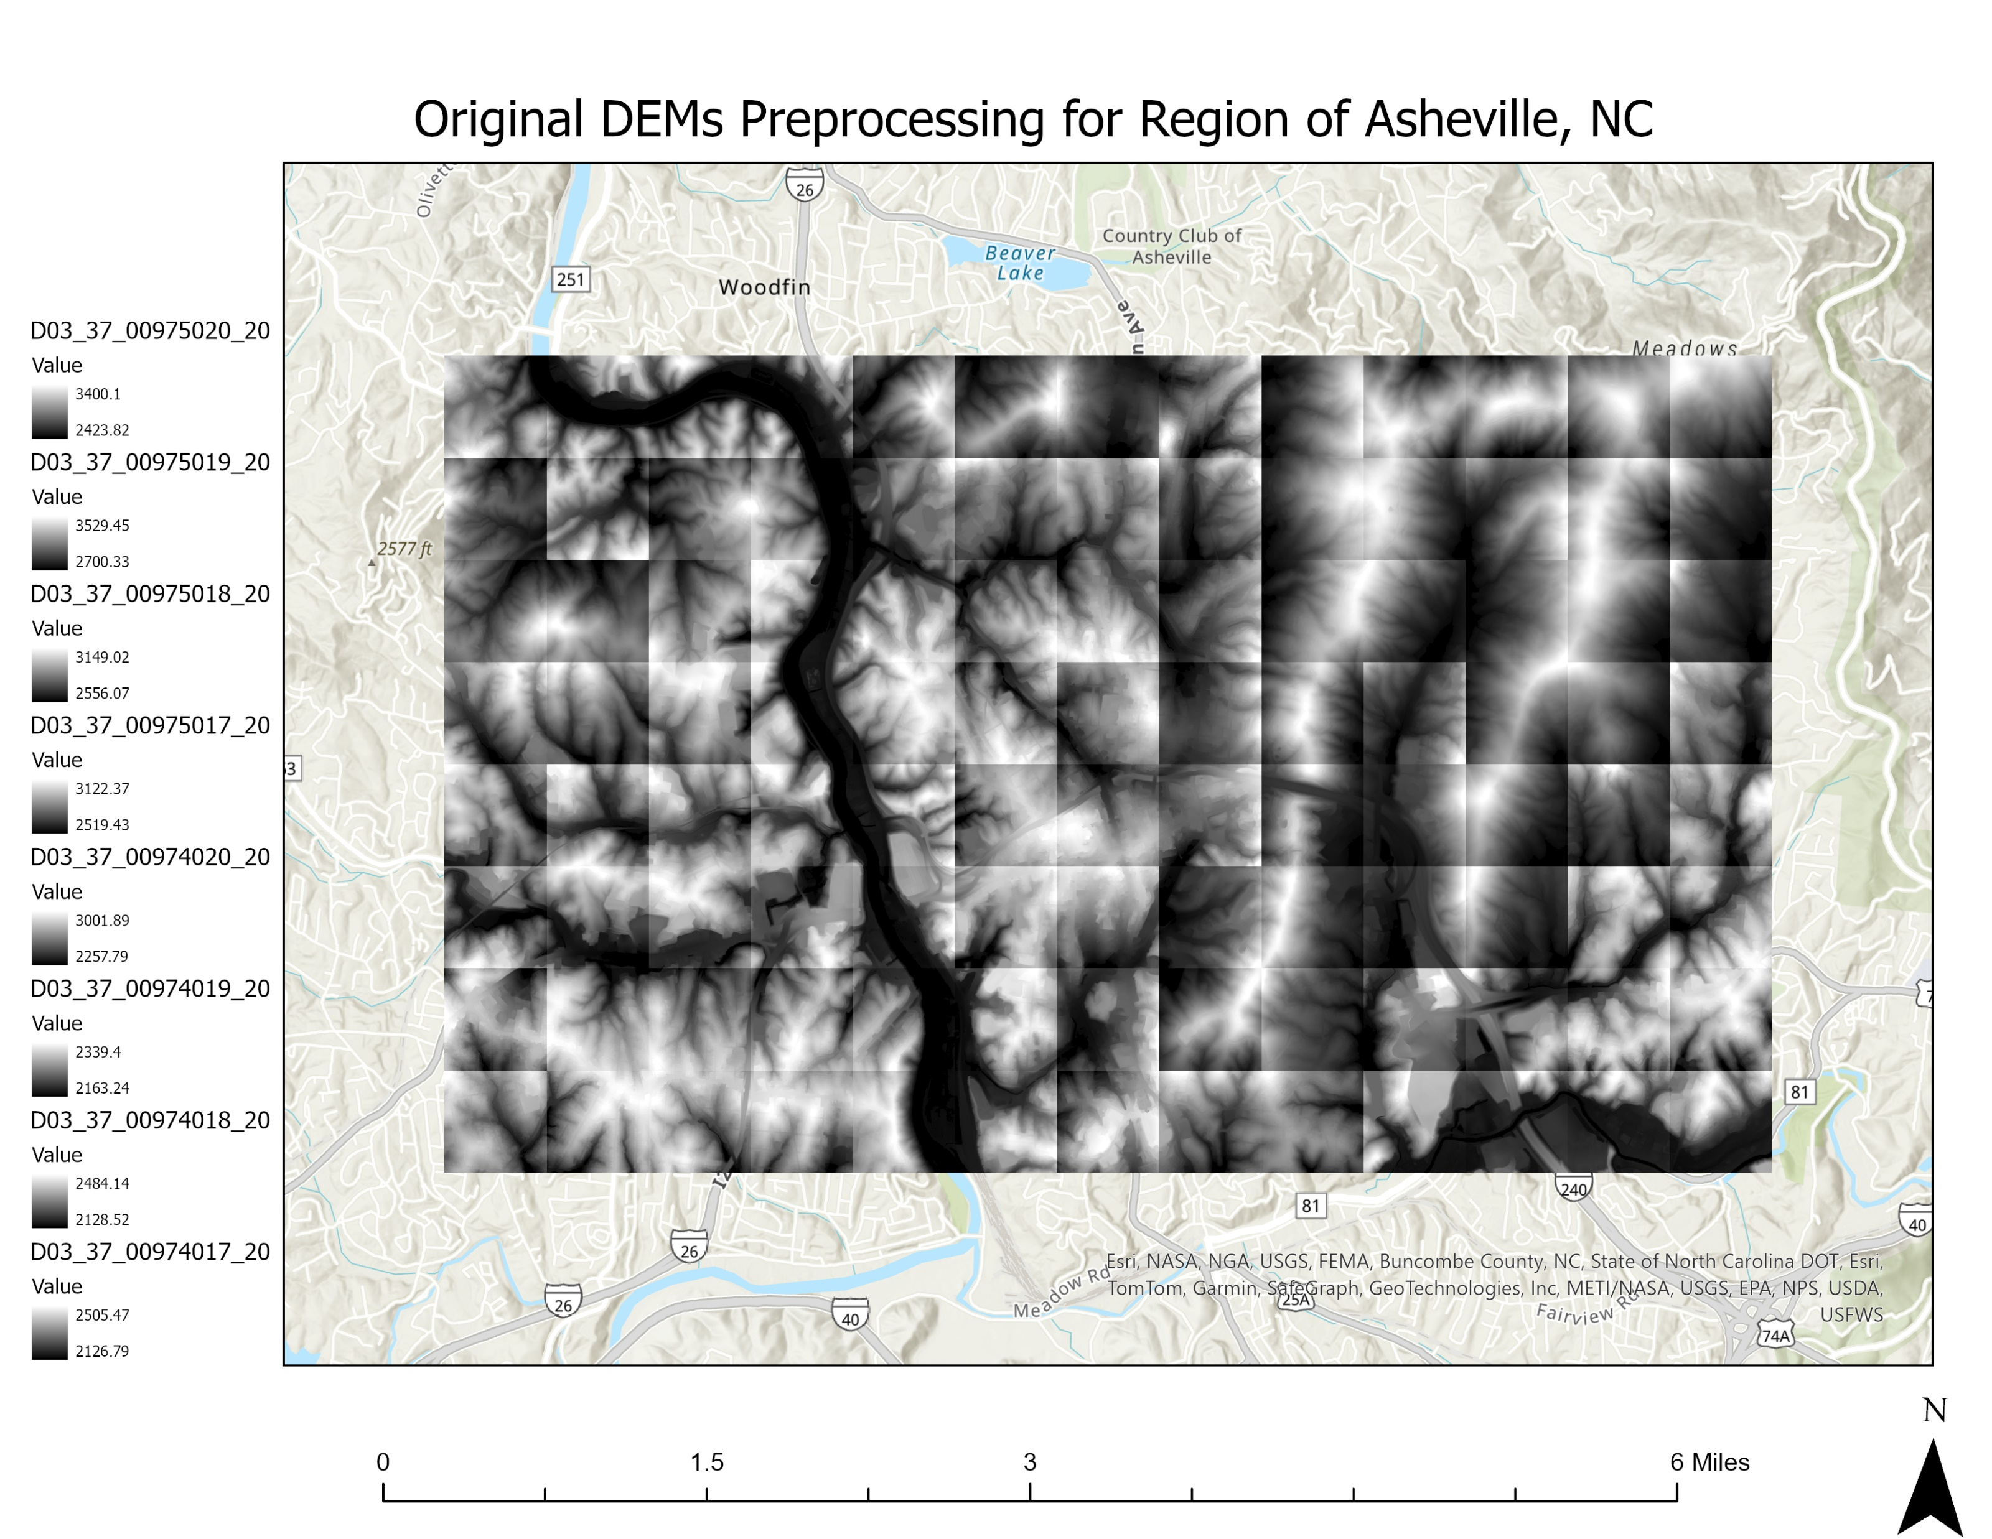
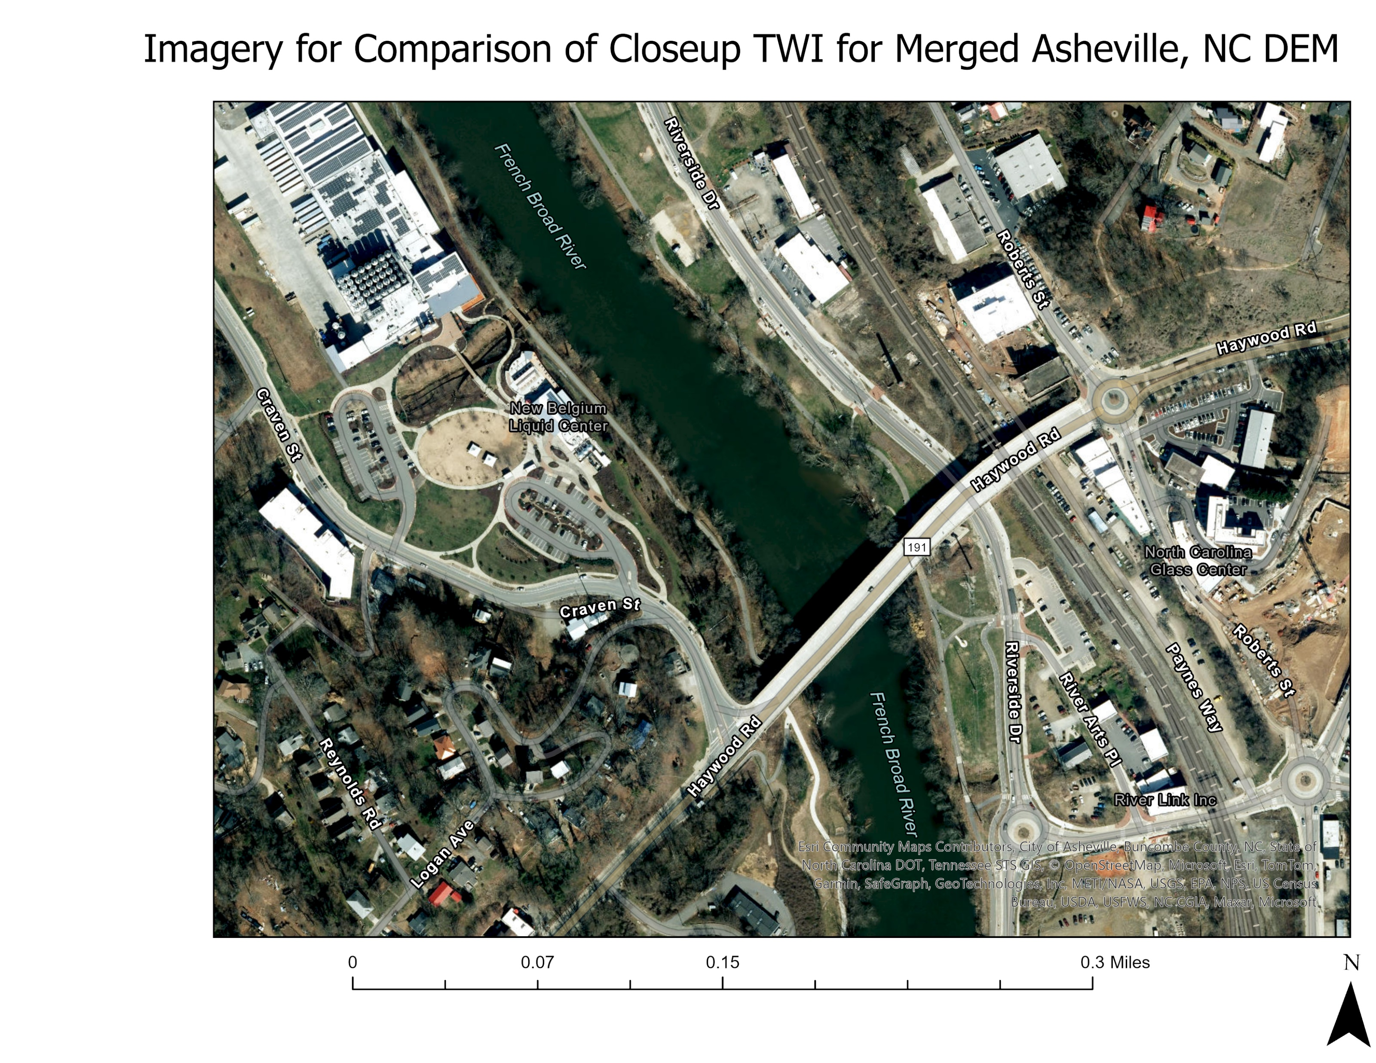
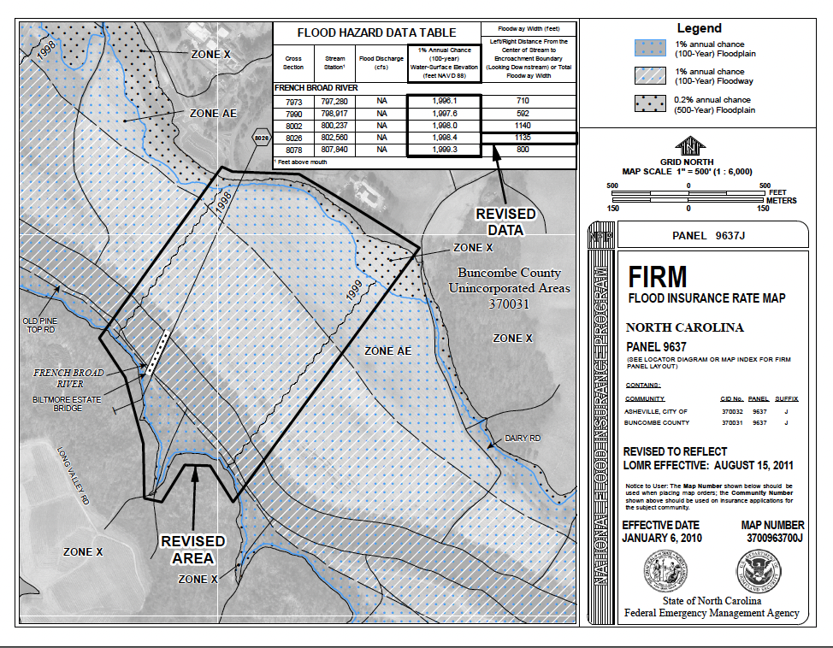
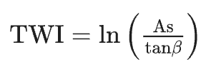
Flood Risk in Asheville, NC using Topographical Wetness Index and Hydrological Modeling
Avi Grant, MS GIS
Abstract
This study applies the Topographic Wetness Index (TWI) to identify potential water accumulation areas in Asheville, North Carolina, focusing on the French Broad River watershed. Using high-resolution DEM data, TWI values ranged from -2.76 to 25.52, with higher values indicating regions prone to soil saturation and flooding. A close-up analysis of a location along the river showed high TWI values correspond to low-lying, flood-prone areas, supported by satellite imagery. These results highlight TWI’s potential for use in flood risk assessment and watershed planning as regions like this face impacts from changing climates into the future.
Introduction
In late September 2024, numerous states experienced significant storm damage and flooding due to Hurricane Helene, which caused river levels to rise rapidly, heavily communities along these rivers. In particular, the western half of North Carolina experienced some of the worst impacts from the storm. This region’s terrain and river networks can make it prone to flash floods and the lack of suitable maps, as described in The Washington Post article, “FEMA flood maps underestimated the risk in North Carolina, analysis shows,” as climate impacts are increasing could be problematic for addressing flood risks.
Study Area and Data
This study area consisted of 104 DEMs, each 3.125 by 3.125 ft for a section of Asheville, NC along the French Broad River, roughly 650000000 sq. feet total in area. In addition, 32-bit floating point format and a CRS of NAD 1983 (2011) StatePlane North Carolina FIPS 3200. I chose this area because Asheville is a major city in North Carolina with 95.06k people as of 2023 and would be impacted by flooding in the French Broad River that runs through it, due to increasing storm severity.
Methods
After first merging the 104 DEMS, I created a raster for slope, flow direction, checked for sinks and then filled the sinks, then made a new flow direction raster based on the filled corrected DEM, and then ran the flow accumulation process (and I snapped the raster files to the original merged DEM).
Next, I converted the slope which was in degrees, to radians using Raster Calculator with the (slope raster in degrees) * 3.14159 / 180.
Then I performed the TWI equation which is:
Where: “As is the upslope contributing area per unit contour length; tanβ stands for the local slope in the steepest down slope direction of the terrain” (Koriche, S. A., & Rientjes, T. H., 2016).
Important note, to calculate TWI in this equation, Ln is used (the natural logarithm of a number to the base of the constant e), but the flow accumulation raster created has some 0 values that will be undefined in the calculation process and will create errors. To remove these errors (those with zero value), the flow accumulation raster need to be rescaled by adding 1 into the formula:
Methods Visualized
2
Results and Discussion
By using hydrological modeling techniques detailed here, I found that TWI ranges from -2.75798 to 25.5249.
This is useful for because it shows where water is likely to accumulate in terrain with elevations that fluctuate, often the regions with values above roughly 9, though this value can differ based on terrain characteristic and the specific study area used in analysis. Thus, TWI provides a relative ranking of where grid cells will become saturated, meaning that cells with higher values are likely to become saturated before cells with lower values. This means that cells with negative TWI values are some of the driest locations in the watershed.
In Figure 5, I provided a closeup of a location along the French Broad River, where you see that the lightest regions start from a TWI of around 1 and the darkest regions in this symbology correspond with higher values of TWI up to 11 roughly, meaning this topography in this subsection is most likely to accumulate water and become saturated, likely during severe storms.
This corresponds with the provided imagery in Figure 5.1 below that together helps to convey that these low elevation regions along the river would be impacted by rainfall that would saturate the soil and could correlate with regions at risk for flooding. By combining TWI results with imagery, it becomes apparent that cells with higher TWI values align with flood-prone zones, conveying practical applications of this project in flood risk assessment and watershed management.
1
3
4
5
Conclusion
The Topographic Wetness Index (TWI) analysis completed here provides useful insights into areas of potential water accumulation and soil saturation within the study area. This project highlights the variability in water retention and inundation in the terrain. Higher TWI values are often associated with low-lying, flat regions near the French Broad River, which are more prone to saturation and potential flooding during severe rainfall events. On the other hand, negative TWI values correspond to drier areas with higher slopes and reduced water accumulation. This analysis demonstrates the usefulness of TWI in understanding terrain saturation risks. Future studies could integrate additional factors, such as soil properties and rainfall intensity into a larger model, to further improve predictions and support disaster preparedness efforts in the region.
5.1
6
Sources
Crowe, K., Osaka, S., & Muyskens, J. (2024, October 13). FEMA flood maps underestimated the risk in North Carolina, analysis shows - The Washington Post. https://www.washingtonpost.com/weather/2024/10/13/fema-flood-maps-hurricane-helene/
Anokye, M., Fawakherji, M., & Hashemi-Beni, L. (2024, July). Flood Resilience Through Advanced Wetland Prediction. In IGARSS 2024-2024 IEEE International Geoscience and Remote Sensing Symposium (pp. 5516-5520). IEEE.
Illinois Flood Maps, Topographic Wetness Index. (2024). University of Illinois. Illinoisfloodmaps.org. https://illinoisfloodmaps.org/topo-wetness-index.aspx
Koriche, S. A., & Rientjes, T. H. (2016). Application of satellite products and hydrological modelling for flood early warning. Physics and Chemistry of the Earth, Parts A/B/C, 93, 12-23.
Spatial Data Download. (2024). NC Emergency Management GIS Section. DEM Data for North Carolina (3ft grid resolution). https://sdd.nc.gov/DataDownload.aspx#
Chowdhury, M. S. (2023). Modelling hydrological factors from DEM using GIS. MethodsX, 10, 102062. https://www.sciencedirect.com/science/article/pii/S2215016123000651
Topographic Wetness Index In ArcGIS Pro - March 23, 2024. (2023, September 20). https://mapscaping.com/topographic-wetness-index-in-arcgis-pro/
‌
Zimmerman, J. (2016, October). GIS topographic wetness index (TWI) exercise steps. https://www.srbc.gov/pennsylvania-elevation-working-group/docs/twi-srbc.pdf
LOMR - French Broad River 11-04-2928P (Hydraulic Model). (2024). Nc.gov. https://fris.nc.gov/fris_hardfiles/nc/hardfiles/file_s_hydramodel/37104020110815100_11-04-2928P-370031.zip
Provided for evaluation, Figure 6 is a flood insurance rate map by the State of North Carolina with revised flood values for a region of the French Broad River as of 2011, which illustrates the risk of water inundation along the riverbank, correlating with the study completed in this project.
Ln(("FlowAcc_FlowDir_Fill_buncombe_cnty_Asheville_DEMs_2019.tif" + 1) / Tan("Slope_radians_buncombe_Asheville_DEM_2019.tif"))

